Slide 1
NYC Taxi Price Pridiction
CSC 570 Big Data
By : Sheraz Ahmed & Shantanu Dharmavat

Slide 2
Introduction
This the project from the Kaggle Competitions and what we are predicting the fare amount for a taxi rides in New York City given the pickup and dropoff locations.

Slide 3
Data Sets
There were two data sets available, the one was for training the model and the other was for testing the models. But we are training and testing using the training data set only. The source for the data sets is Kaggle:
https://www.kaggle.com/c/new-york-city-taxi-fare-prediction/data

Slide 4
What were given to us ?
The things available for this project was only the two set files, that are:
Train.csv
Test.csv

Slide 5
What we need to predict ?
The End goal for this project is to predict the estimated fare price for taxi rides in the New York City area. It was required by the Kaggle that RMSE of the predictions should be between $5 - $8.

Slide 6
Attributes of the Data Set
Since we are using the training data set only, the attributes of this data set are described below :
Size : 5.8 GB
Format : .csv
No of attributes : 08
Types of attributes : TimeStamp, Double, Integer, String

Slide 7
Feature Attributes
pickup_datetime - timestamp, value indicating when the taxi ride started.
pickup_longitude - float, for longitude coordinate of where the taxi ride started.
pickup_latitude - float, for latitude coordinate of where the taxi ride started.
dropoff_longitude - float, for longitude coordinate of where the taxi ride ended.
dropoff_latitude - float, for latitude coordinate of where the taxi ride ended.
passenger_count - integer, indicating the number of passengers in the taxi ride.

Slide 8
Target Attribute
fare_amount - float, dollar amount of the cost of the taxi ride.
(This value is only in the training set)

Slide 9
Environment
We are making this project using the cluster provided by the university on yarn using spark framework. We are using jupyter notebook for coding in Scala and zeppelin for the visual representations.

Slide 10
Approach
We using Regression for the prediction of fare amount:
We are using four Regression Algorithms:
Linear Regression
Gradient boosted Tree Regression
Random Forest Regression
Decision Tree Regression

Slide 11
Preprocessing
The training set contained 8 columns,
Key
Pickup_latitude
Pickup_longitude
Dropoff_latitude
Dropoff_longitude
Date_time
Passenger_count
Fare_amount

Slide 12
PreProcessing
The key and datetime columns were removed from the data frame
We calculated the absolute difference between the pickup and drop-off latitude and longitude values and the distance in kilometers between the pickup and drop-off location values
We did two separate set of evaluation one using the absolute difference and the kilometer difference between the lat long values

Slide 13
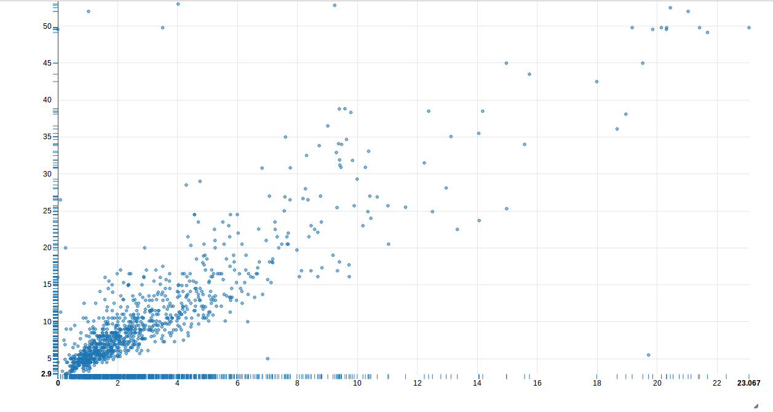
By looking at the scatter plot it can be observed that there is a visibal linear correlation between the distance and the fare amount of the ride

Slide 14
Correlation value
We calculated the correlation between the fare amount and the absolute difference between the pickup and drop-off lat long values and the kilometer difference between the same lat long values
The correlation between the absolute lat and long difference are 0.5197 and 0.6946 respectively and the correlation between the kilometer difference and fare amount was 0.9
From this we came to the conclusion that the kilometer difference was the most important feature

Slide 15
Linear Regression :
Linear regression with the distance feature had the Root Mean Squared Error of 5.16
The RMSE from the absolute difference was 6.74

Slide 16
GBT
The RMSE for Kilometer difference is 4.69
The RMSE for absolute difference is 4.79

Slide 17
Random Forrest Regression
The RMSE for Kilometer difference is 5.08
The RMSE for absolute difference is 5.13

Slide 18
Decision Tree
The RMSE for Kilometer difference is 4.95
The RMSE for absolute difference is 5. 12

Slide 19
Conclusion
The Best results for the data set with the lowest RMSE of 4.69 were obtained using GBT regression on the dataset containing the kilometer difference between the pick up and drop off locations.
The Kaggle competition asked for a RMSE of $5 - $8 range but we were able to get a $4.69

Slide 20
Possible Improvements
We can use the pick up date and time to get a more robust understanding of fare variations based on different months, day of the week, Holidays etc.
Used bounding boxed to remove locations points based outside the city limits
Use the entire dataset -- here we're only using about 25% of the training data!
Try to find more outliers to prune, or construct useful feature crosses.

Slide 21
Any Question ?

Slide 22
The End
Thankyou

